Slide 1

JavaScript Basics
GitHub Repo
GitHub Pages
Marcello Comandulli
Front End Web Developing Student

Slide 2
Contents
Structure and Media Queries …………….. 03
Code Analysis …………….. 05

Slide 3
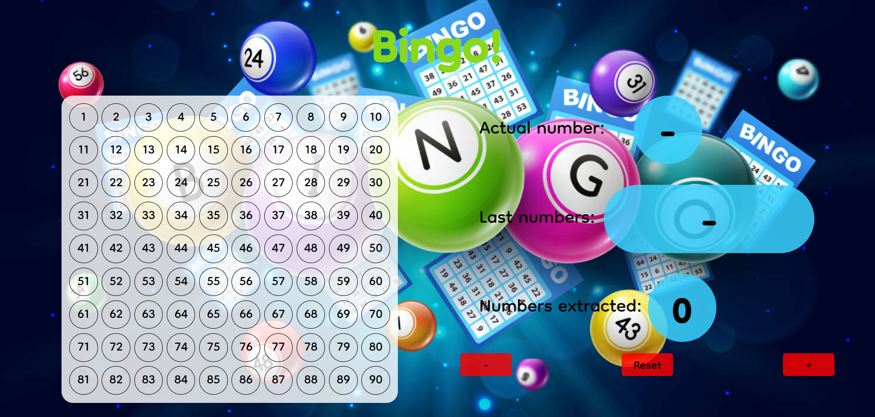
STRUCTURE AND MEDIA QUERIE
It’s made up of 1 responsive page.
Desktop design shows a big board on the left and on the right there are the counter, 2 spaces dedicated to the last and the last four numbers extracted.

Slide 4
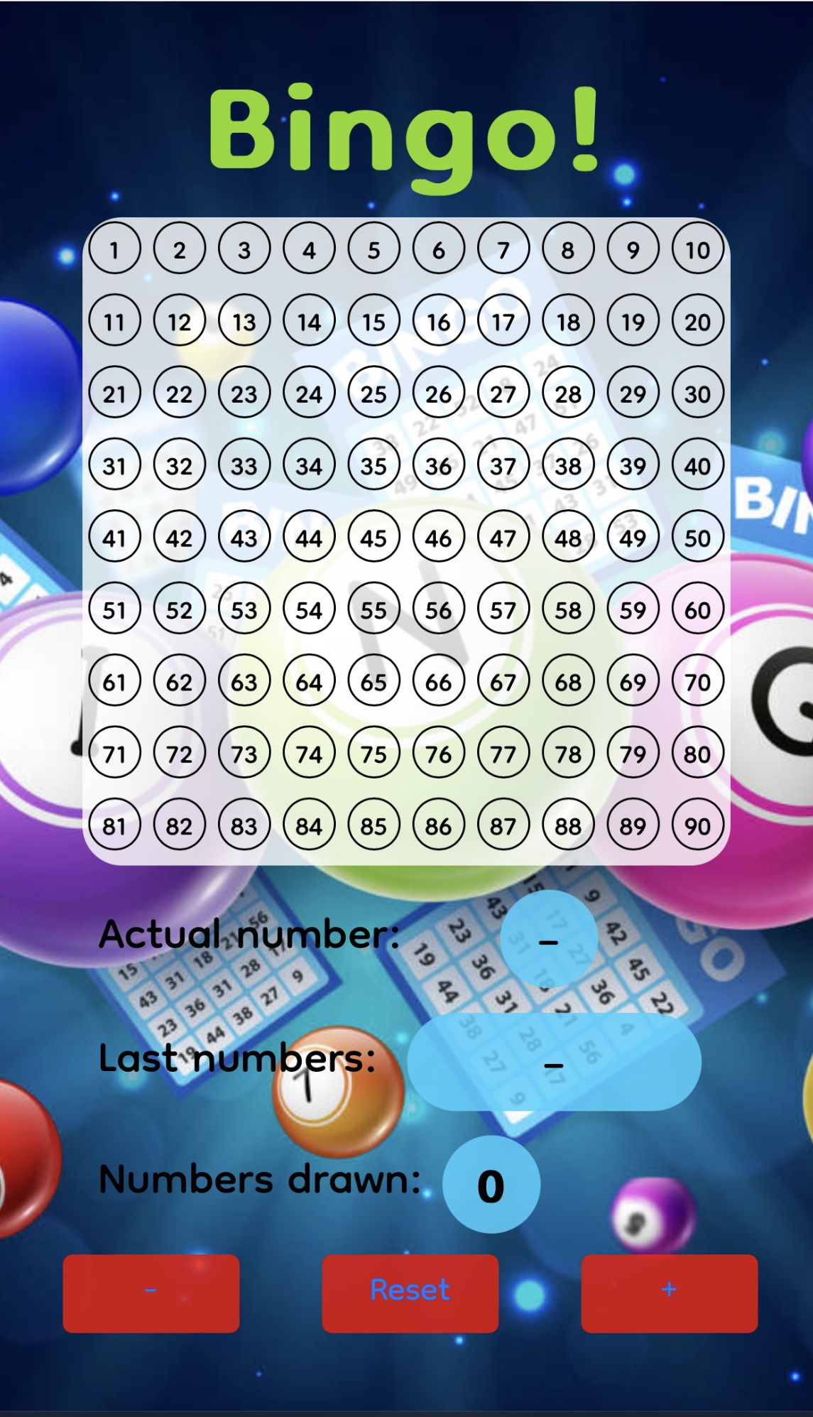
Mobile design shows them on a column design.
Media querie breakpoint: 800px.

Slide 5
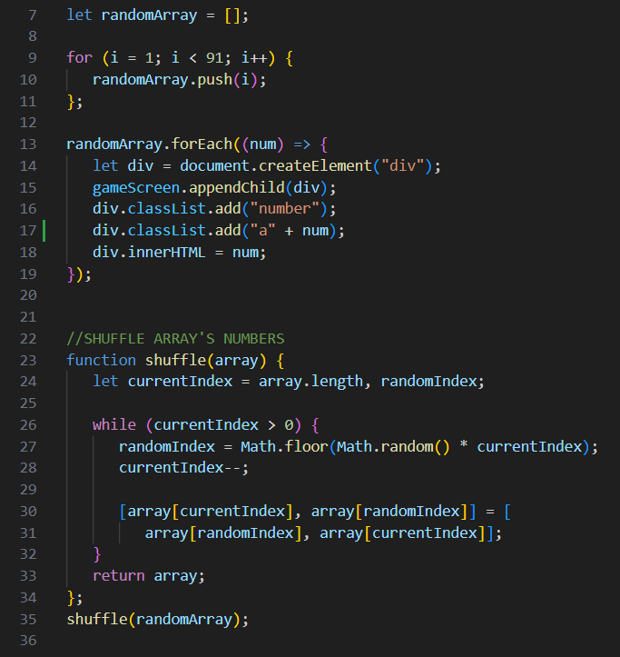
JS CODE ANALYSIS
Thanks to a for loop I filled an array and I generated 90 divs to fill the board with its numbers.
Every div has:
a “number” class to give it a specific design;
a (“a” + num) class to identificate it precisely.
The function “shuffle” is usefully to mix randomly numbers in the previous array.

Slide 6
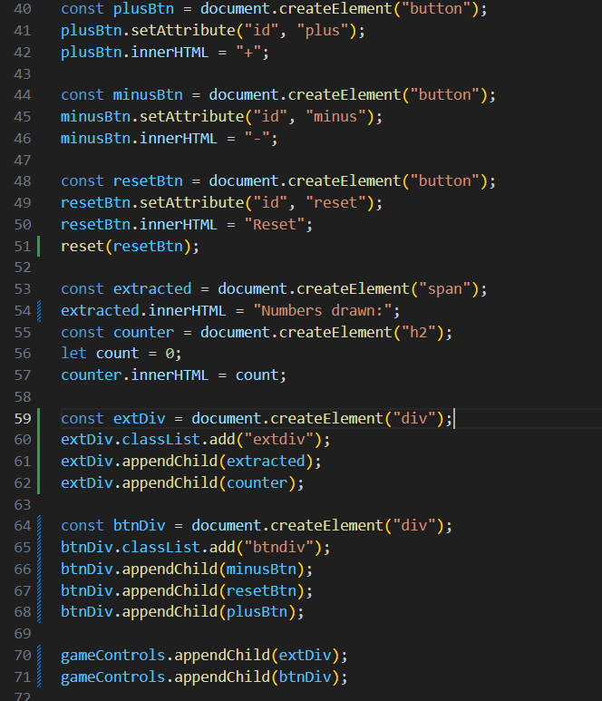
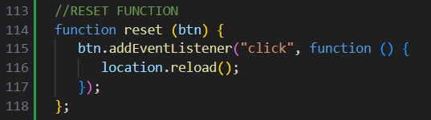
JS CODE ANALYSIS
Here I reached my target:
“The user, upon entering the page, will display 0 as the counter value and will have 2 +/- buttons to change the counter value.”
I added also a reset button to restart game.

Slide 7
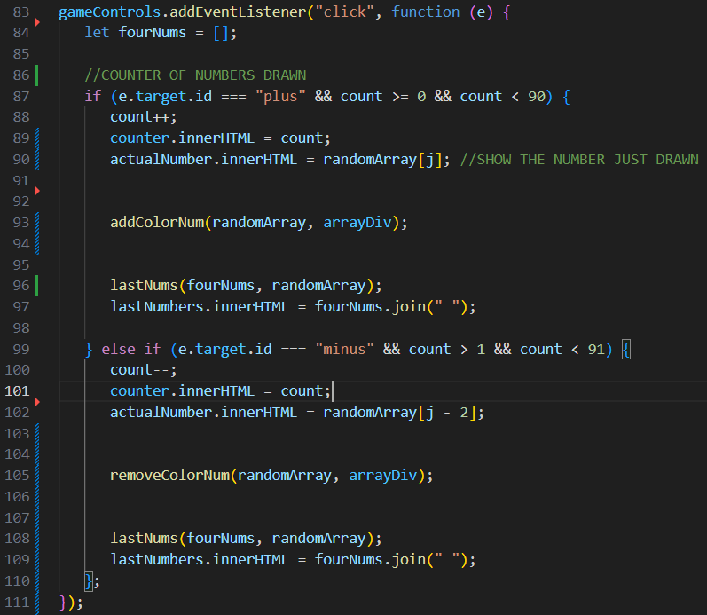
JS CODE ANALYSIS
Inside the Event Listener there is the core of the whole code.
It increses or decreses the counter when the user click on “+” or “-” button.
Show the number just drawn.
Recognizes this number and color its background on the white board.
Keep printing on screen the last 4 numbers drawn.

Slide 8
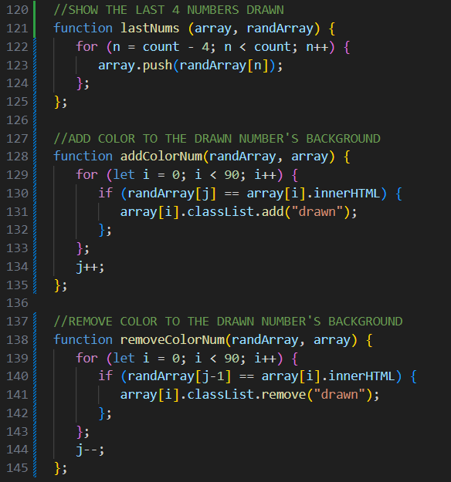
JS CODE ANALYSIS
These are three functions inside the Event Listener.
It prints only the last 4 drawn numbers.
It adds a specific class to the div, to make it visible on the board when contains a number just drawn.
It removes the class we were talking about from the div.

